Slide 1
Slip-lines

Slide 3
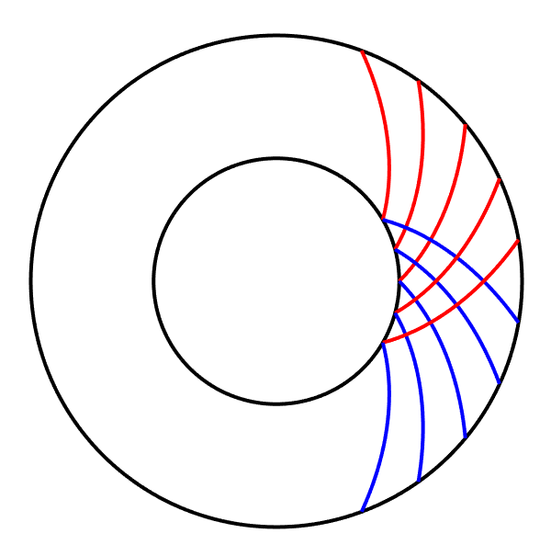
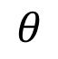
B
$$θ$$
A
r = a
r = b

Slide 4
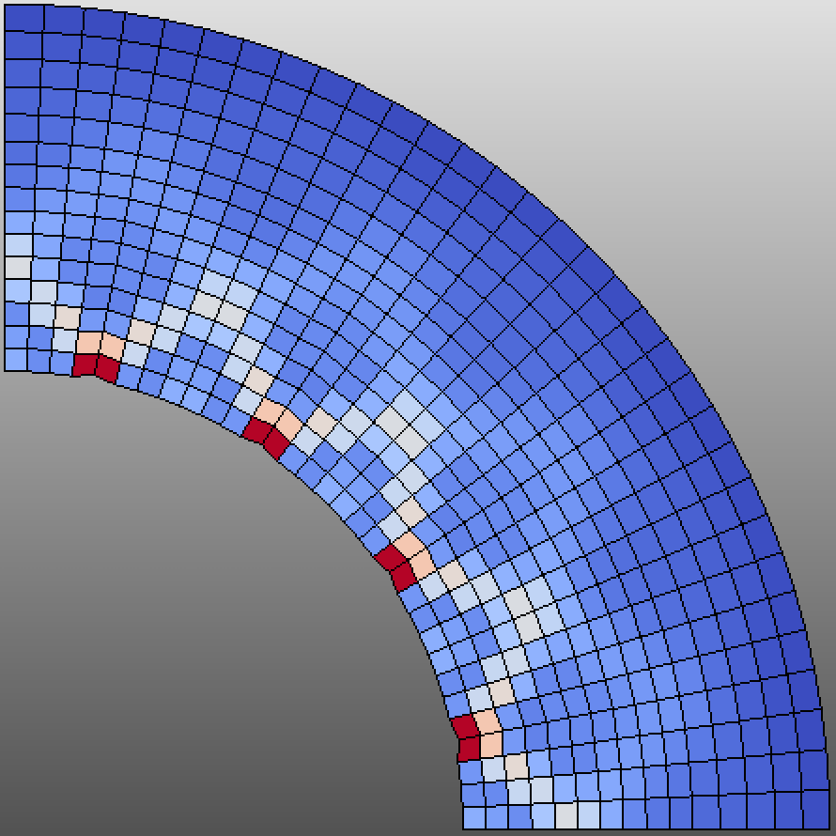
A₁
A₂
A₃
A₄
o

Slide 5
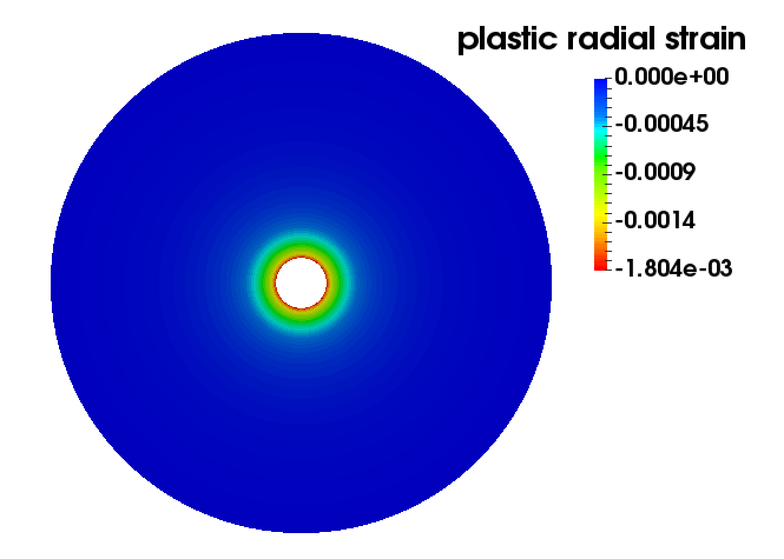
Plasticity zone

Slide 6
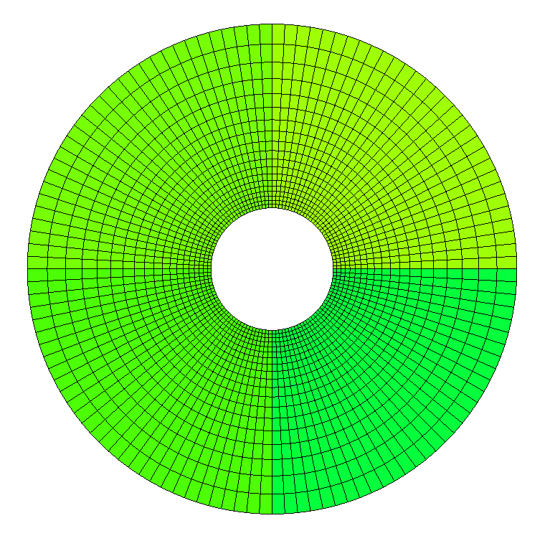

Slide 7

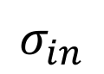
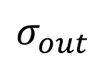
$$σ_{out}$$
$$σ_{in}$$
y
x

Slide 8
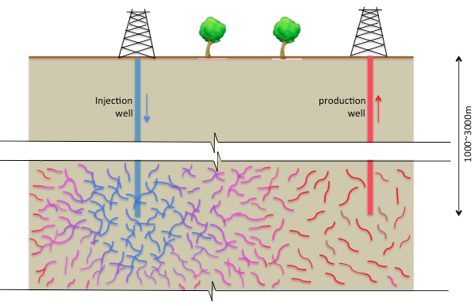
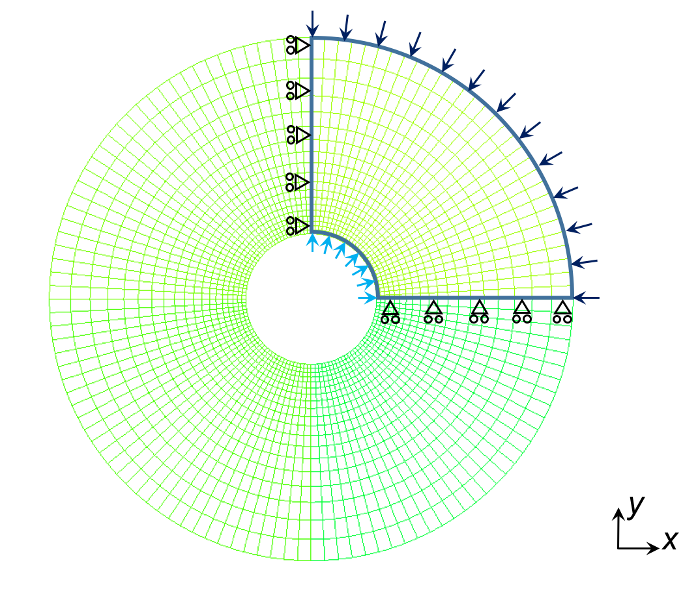
h
(a)
(b)

Slide 9
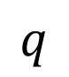
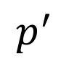
$$q$$
Drucker-Prager
Yield Surface
Slope of the yield surface
$$p^{′}$$
(a)
(b)

Slide 10
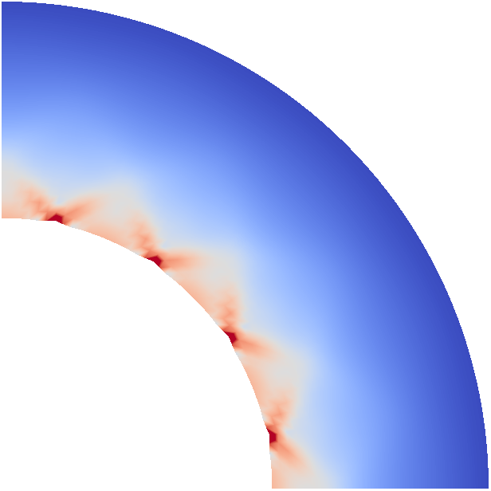
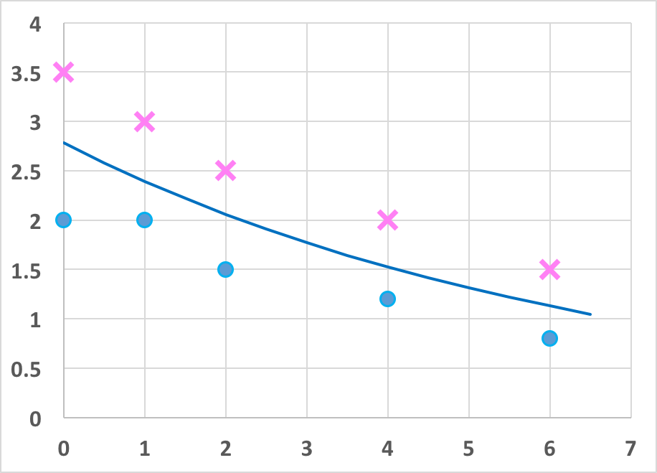
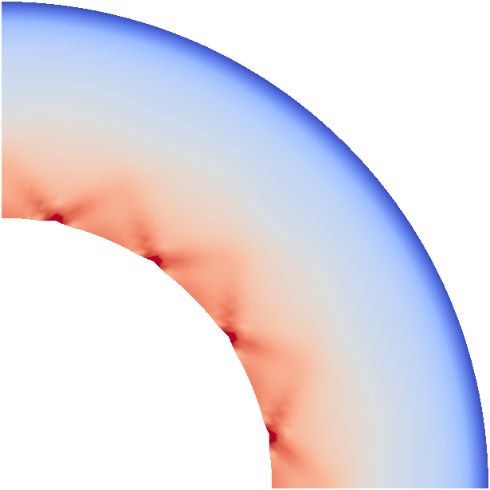
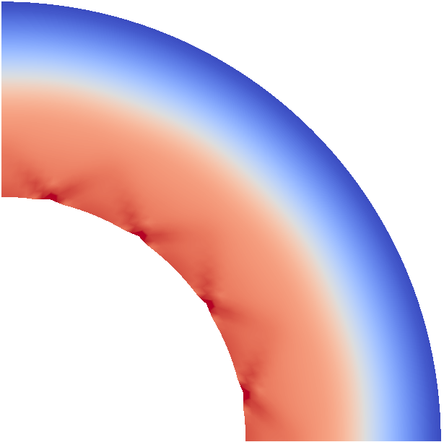



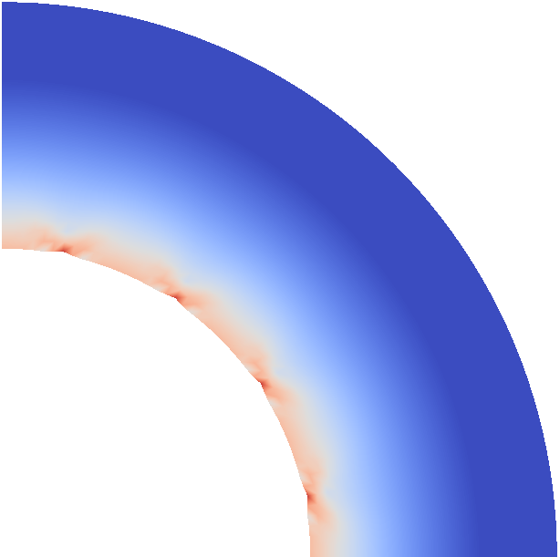
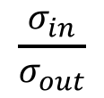
$$\frac{σ_{in}}{σ_{out}}$$
Arrhenius Number

Slide 11
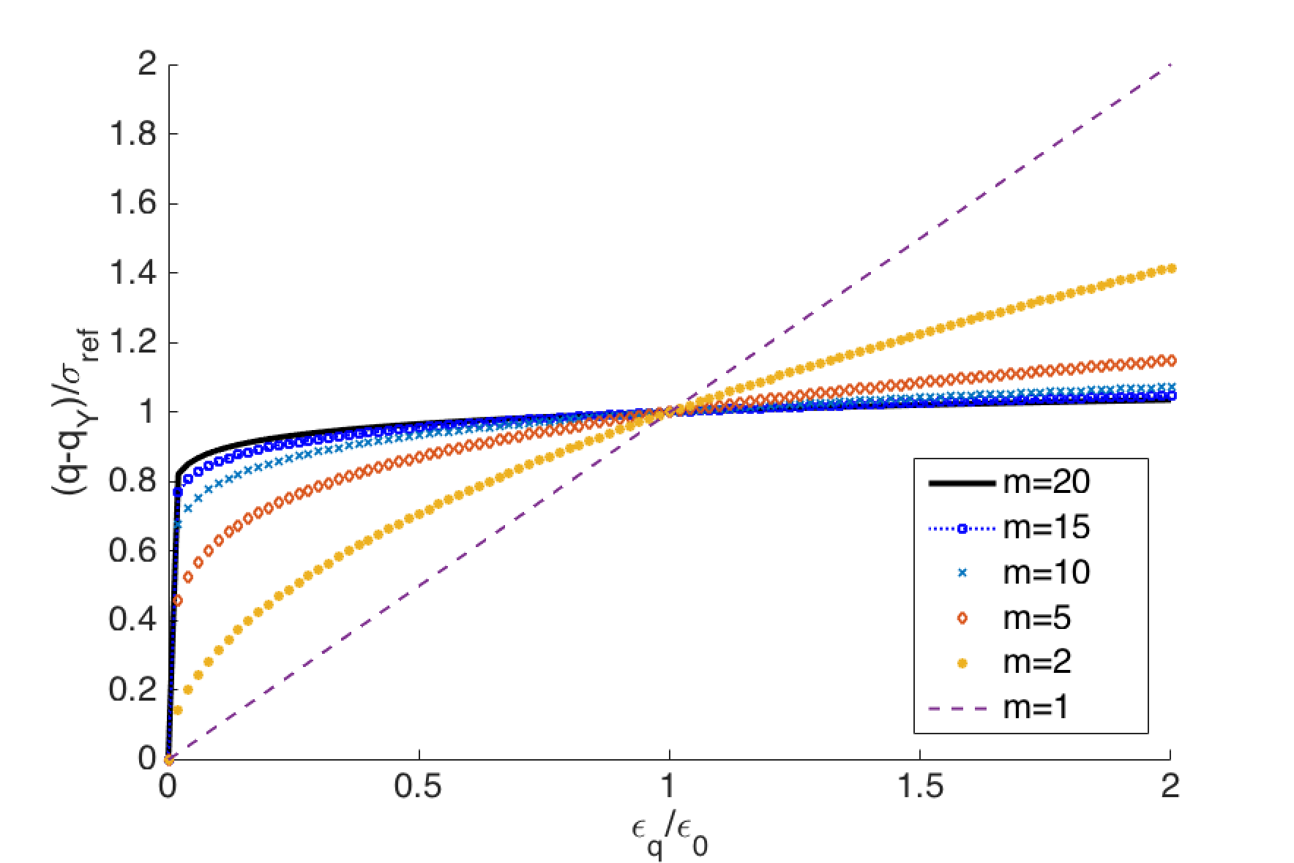
$$∙$$
$$∙$$

Slide 12
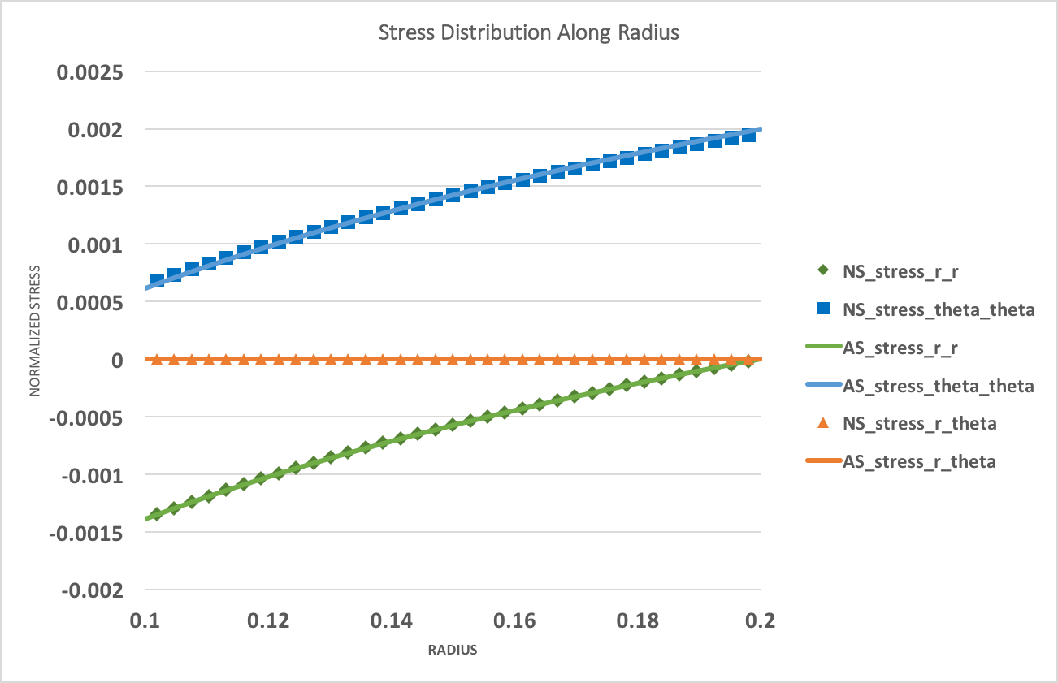
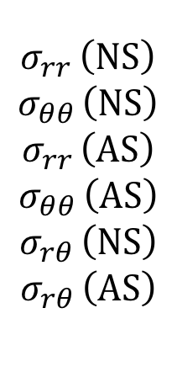
Normalized stress components
$$σ_{rr }\left(NS\right)$$
$$σ_{θθ }\left(NS\right)$$
$$σ_{rr }\left(AS\right)$$
$$σ_{θθ }\left(AS\right)$$
$$σ_{rθ }\left(NS\right)$$
$$σ_{rθ }\left(AS\right)$$
Normalized radius from the interior to the exterior of cylinder

Slide 13
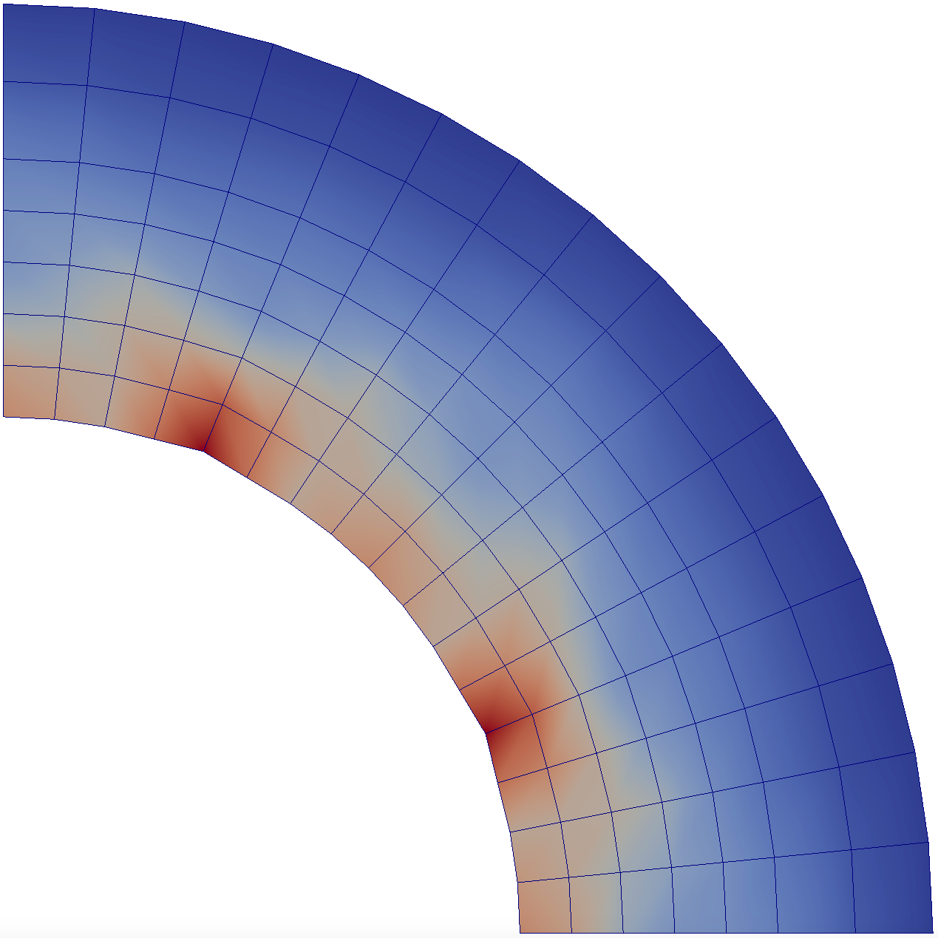
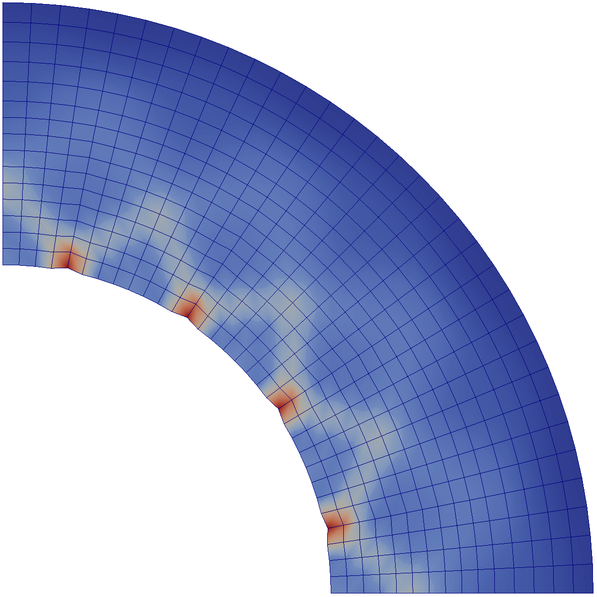
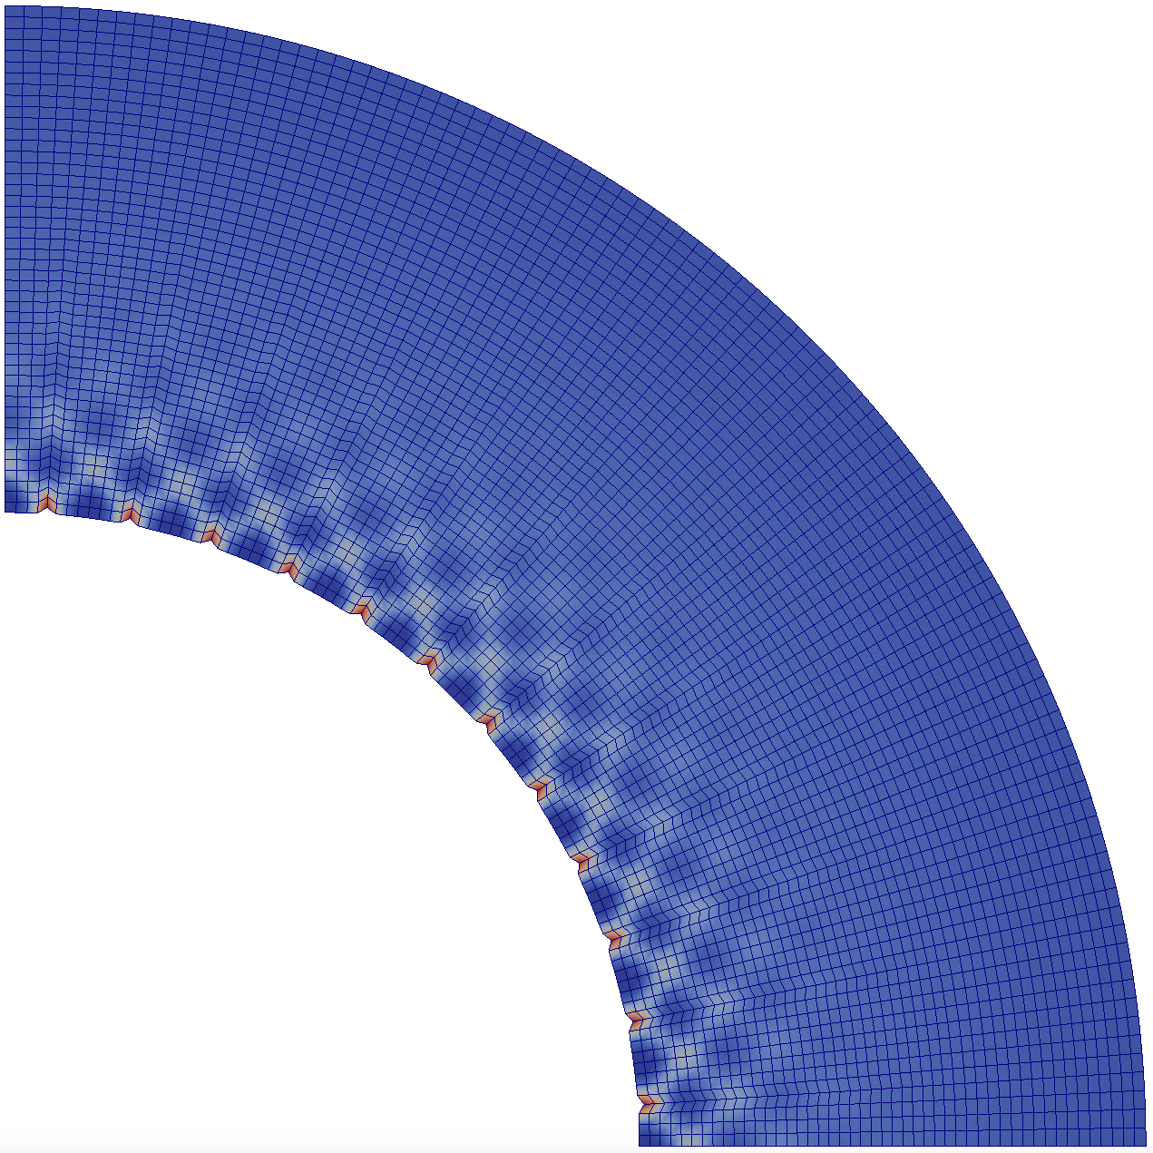
20
25.5
31
36.5
42
19
30
41
52
63
10
40
70
100
130
Mechanical dissipation
Mechanical dissipation
Mechanical dissipation

Slide 14
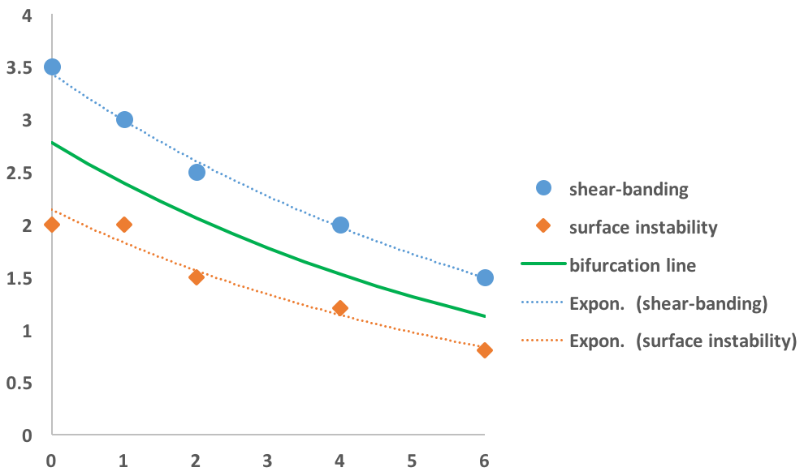
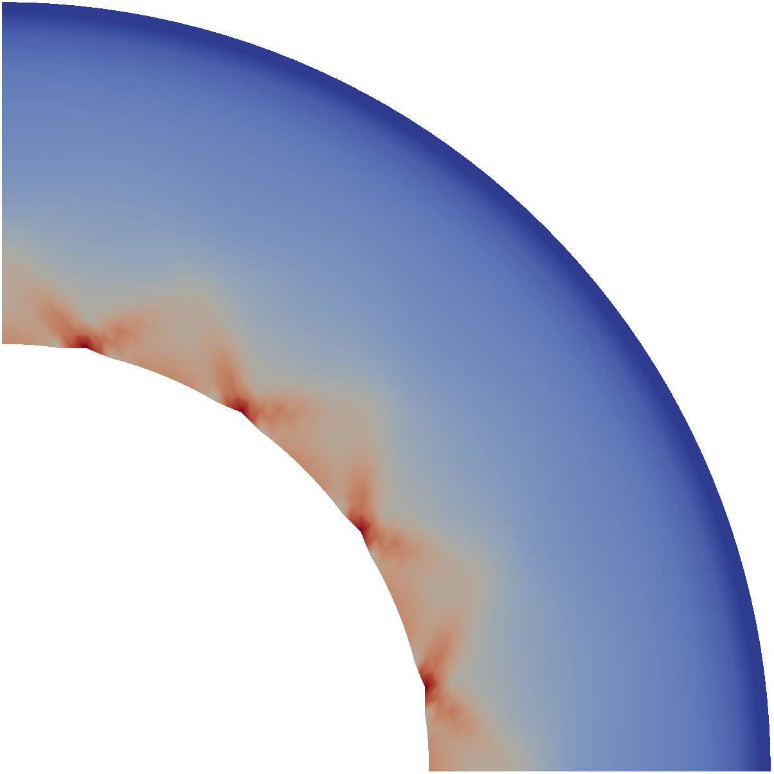

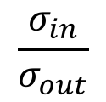
0.158
damage
0.148
$$\frac{σ_{in}}{σ_{out}}$$
0.156
damage
0.074
Arrhenius number

Slide 15
0.158
damage
0.148
$$\frac{σ_{in}}{σ_{out}}$$
0.156
damage
0.074
Arrhenius number

Slide 16
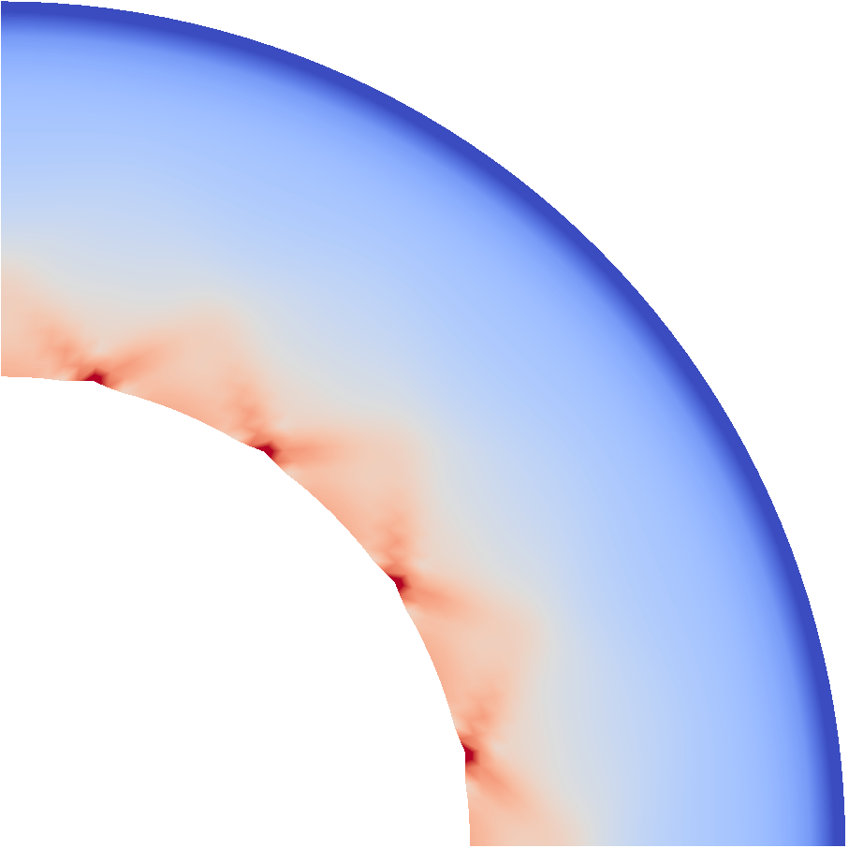
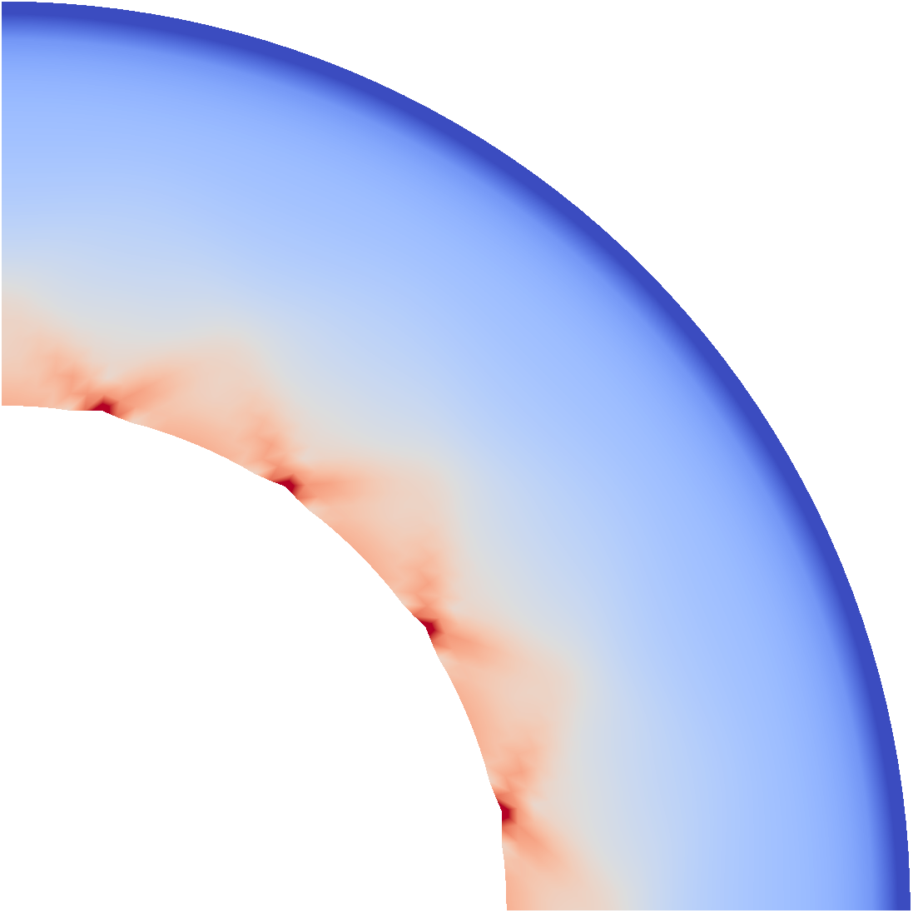
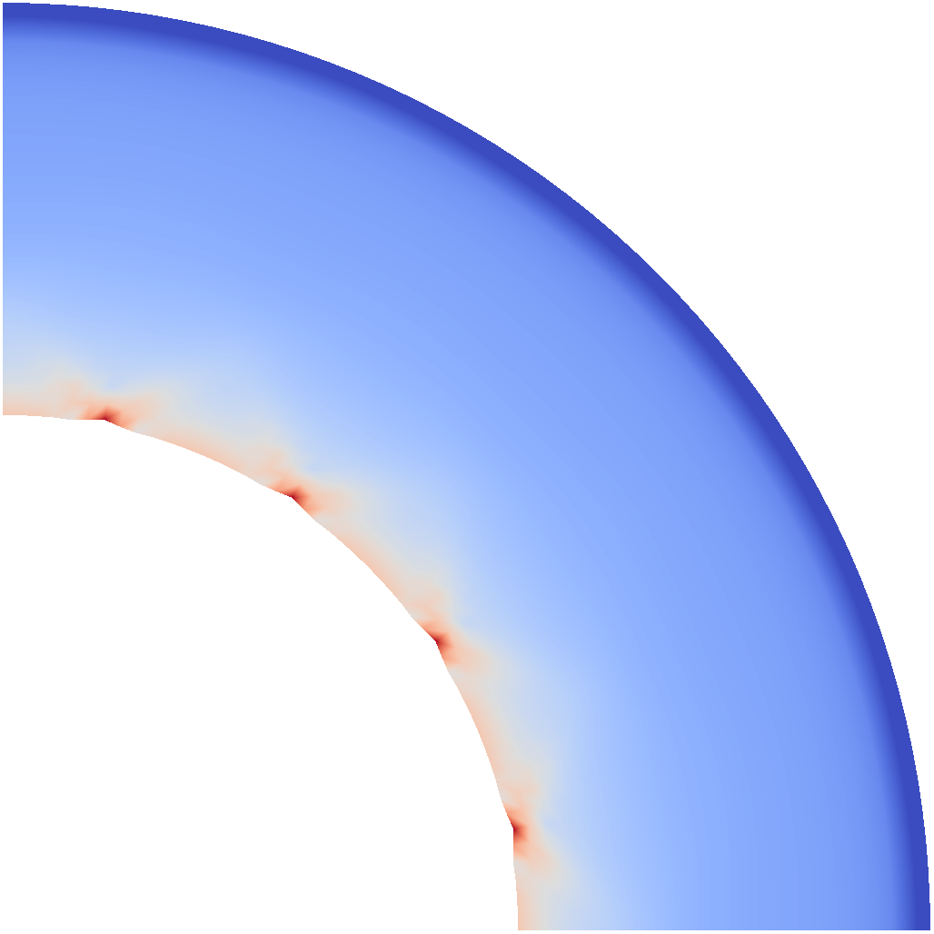
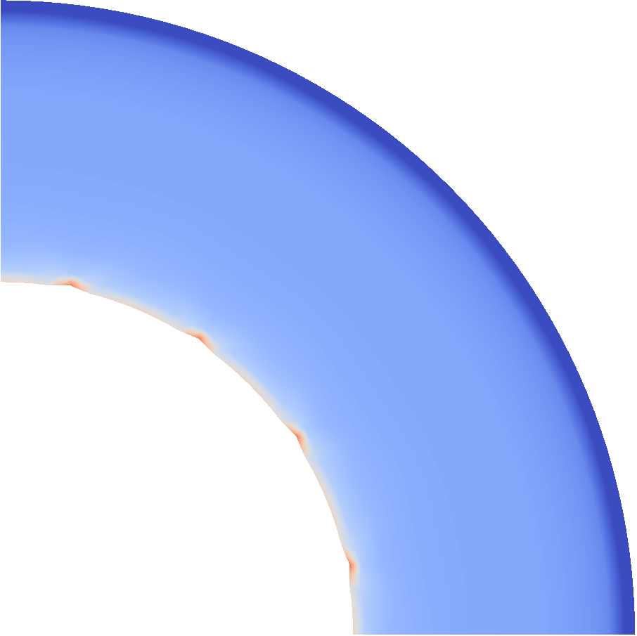
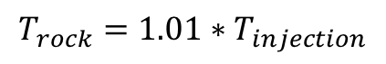
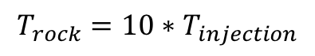
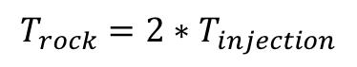
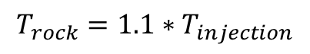
$$T_{rock}=1.01∗T_{injection}$$
$$T_{rock}=1.1∗T_{injection}$$
$$T_{rock}=2∗T_{injection}$$
$$T_{rock}=10∗T_{injection}$$
0.158
damage
0.148

Slide 17
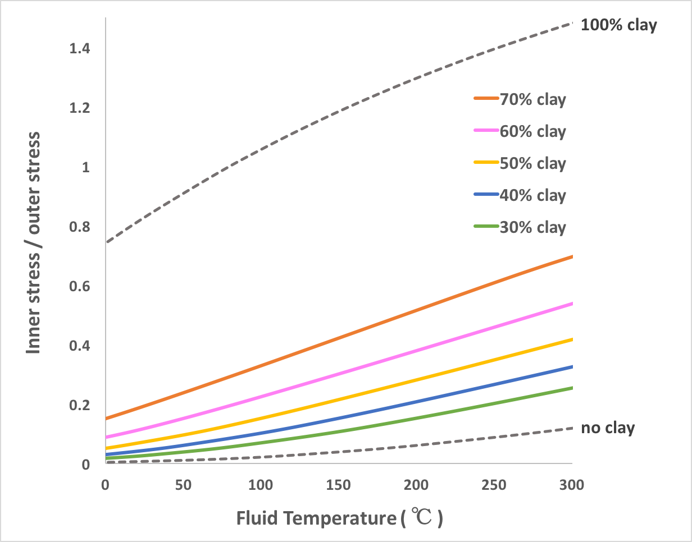
Shear-banding mode

Slide 18
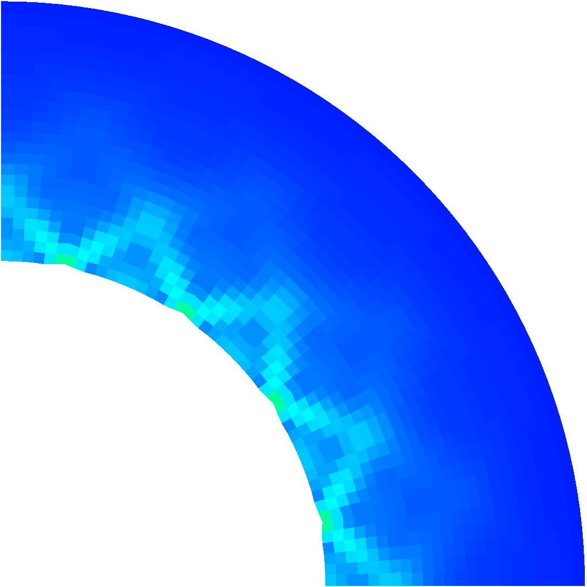



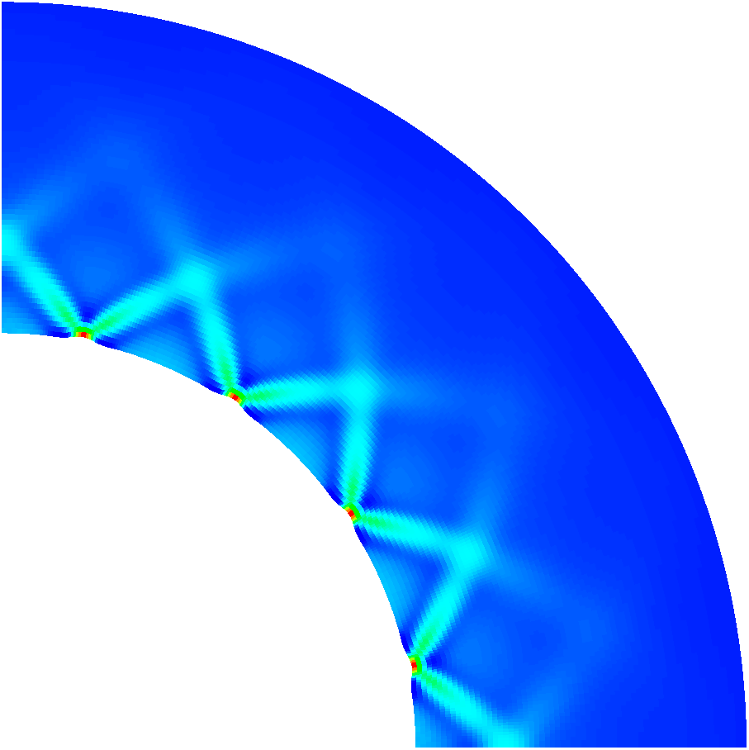

0.176
Mechanical dissipation
0.0026

Slide 19
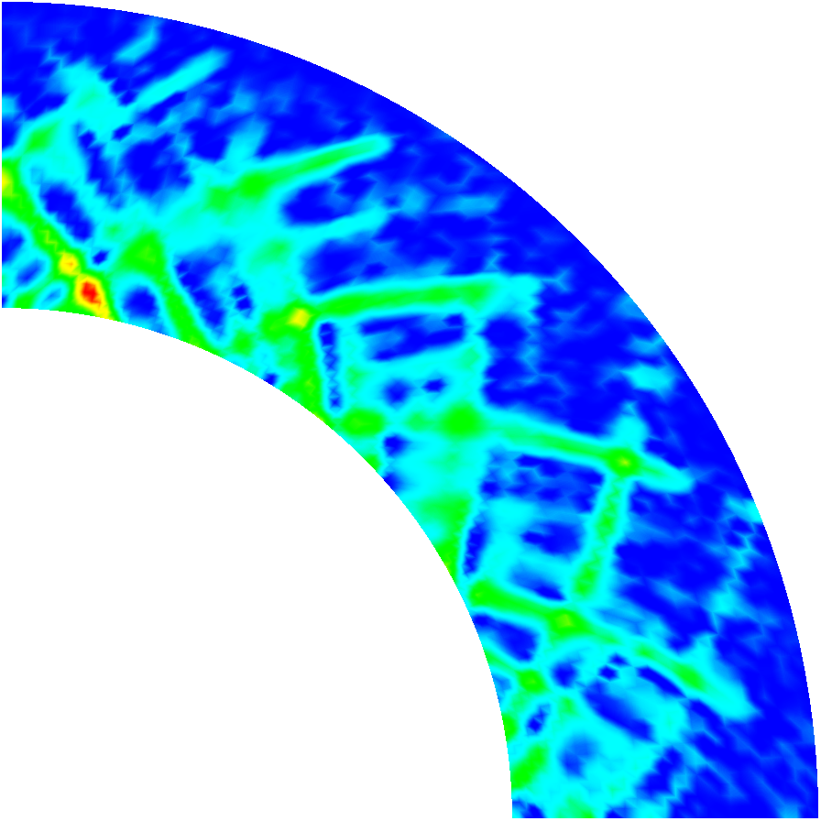
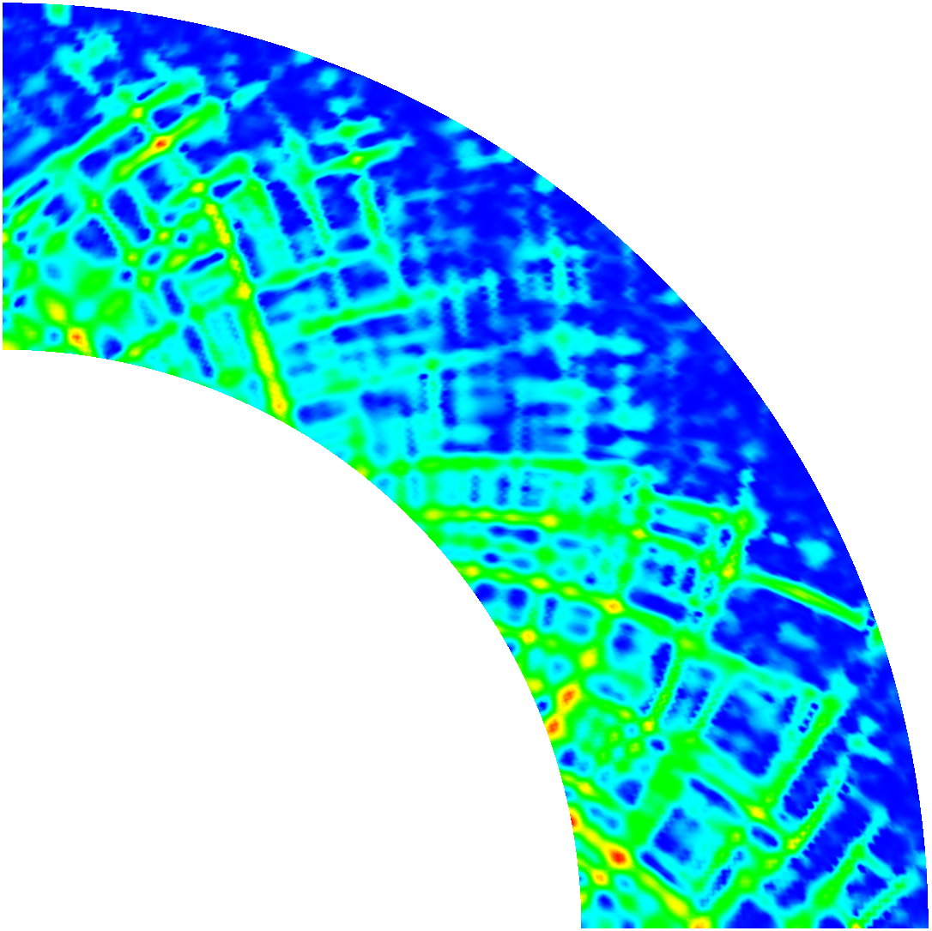
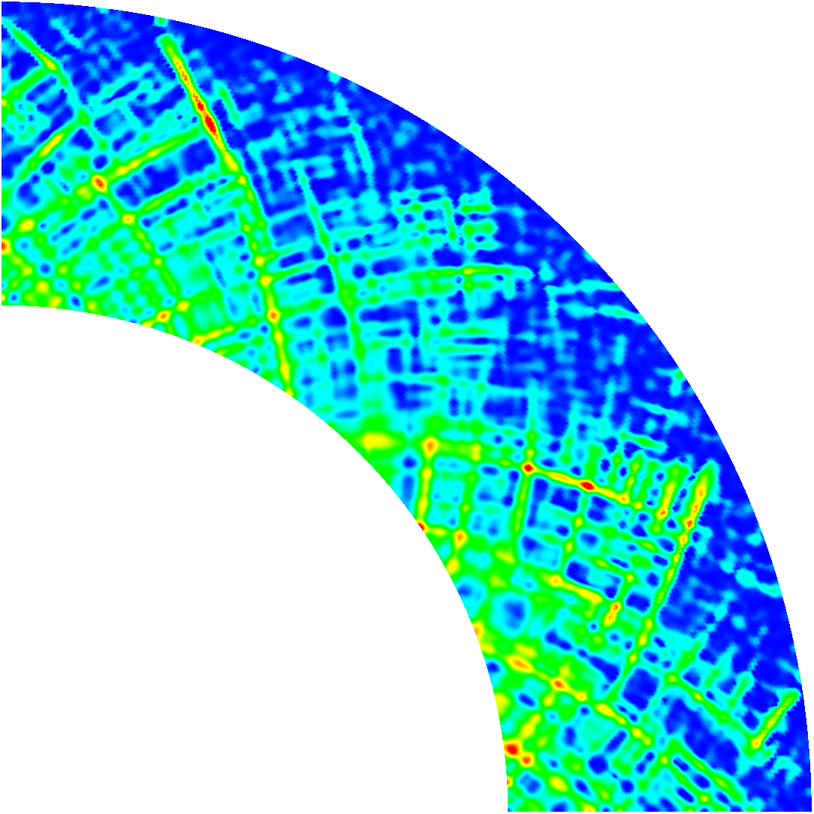
20
Normalized temperature
0

Slide 20
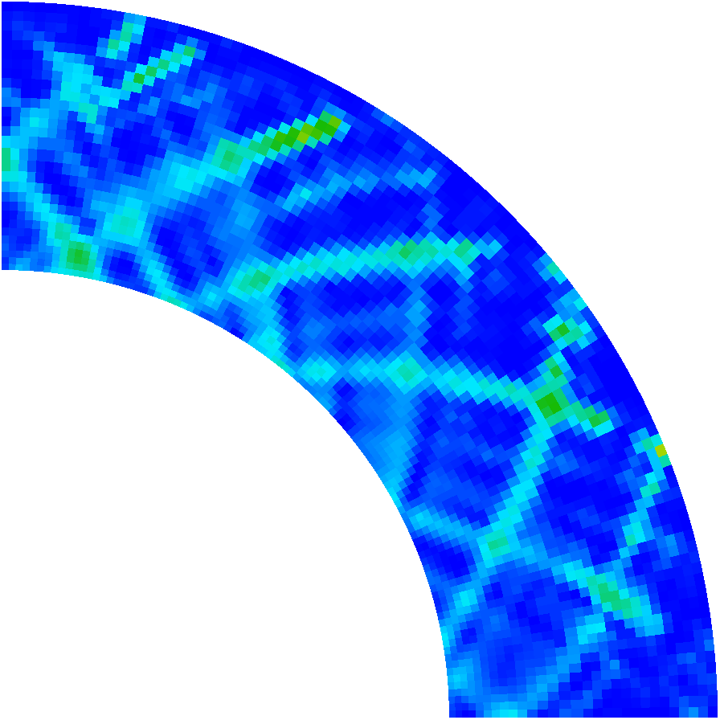
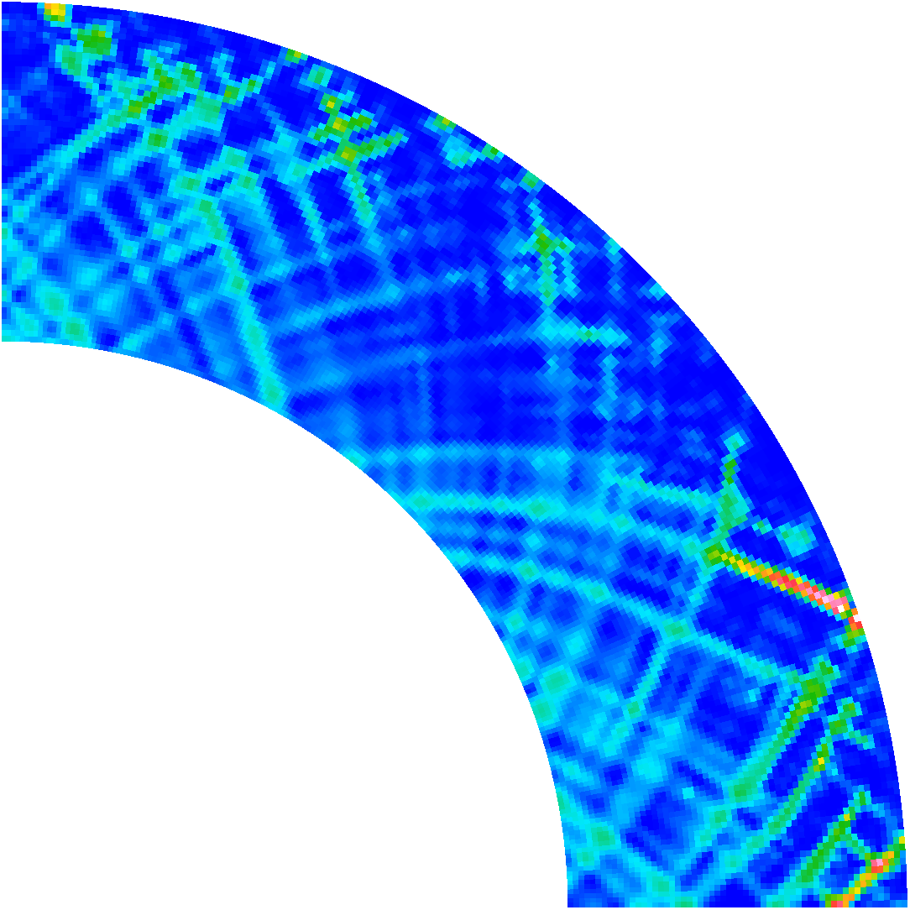


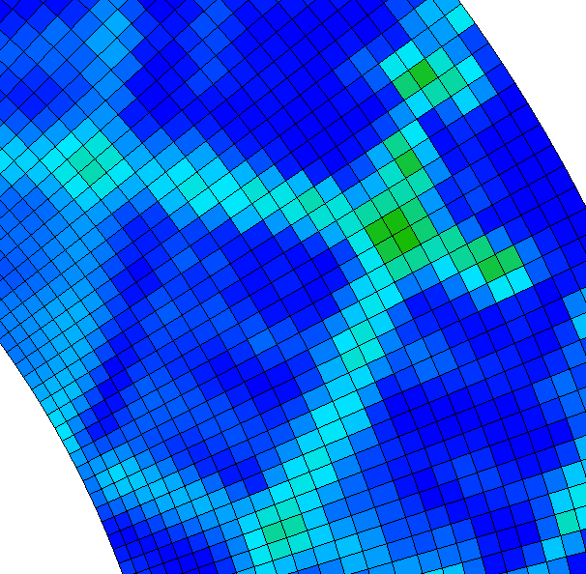


16
Normalized dissipation
0

Slide 21
